Slide 1
Team Budget Planner

Slide 2
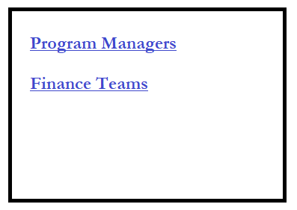
Main Page

Slide 3
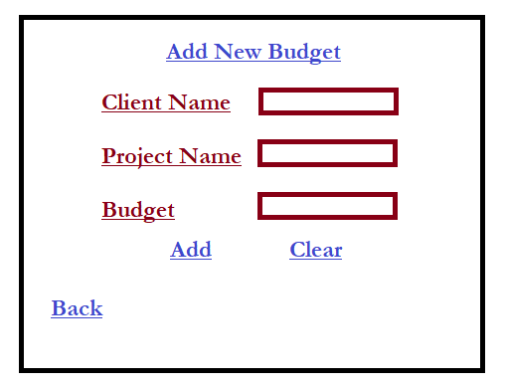
Program Managers

Slide 4
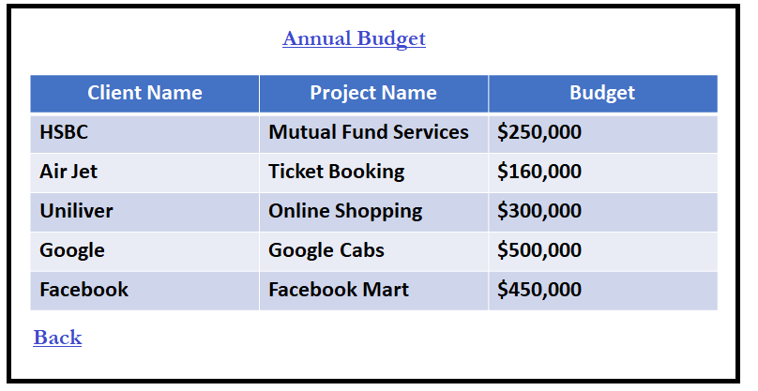
Finance Teams
Note: Display the total budget of all the projects below the table

Slide 5
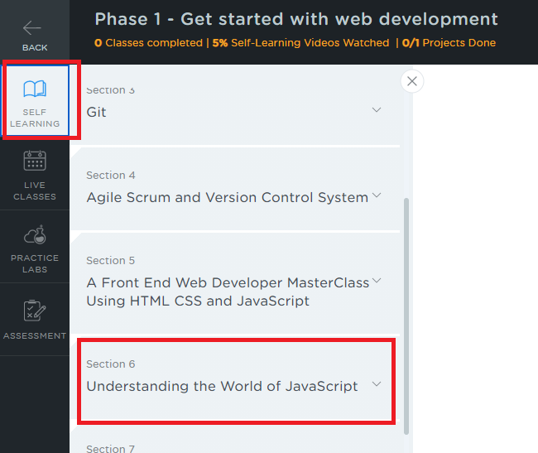
Project Submission Steps
Choose self learning and scroll down to Section 6 – Understanding the world of Javascript

Slide 6
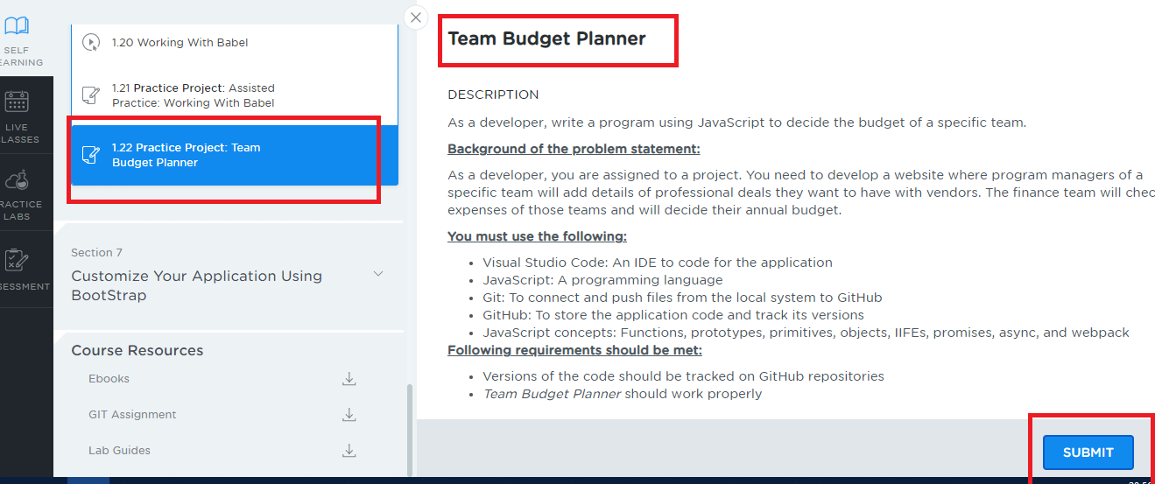
Project Submission Steps
Choose section 6, click lesson 1 and scroll down to the sub-section 1.22 which has a Practice Project – Team Budget Planner, click on it you will see the description and submit button

Slide 7
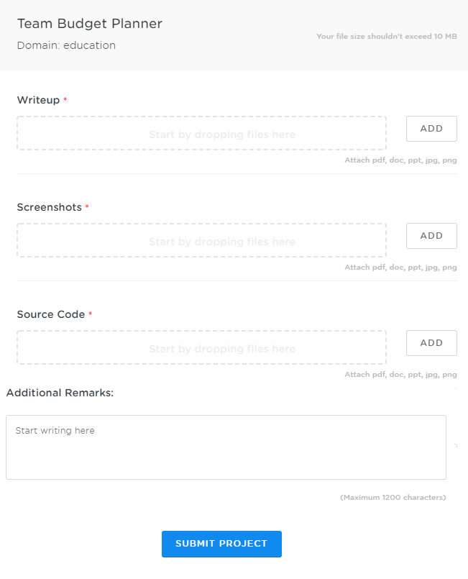
Project Submission Steps
After you click on submit you will get a window as below
Things to submit:
Writeup:
Upload a document that will have the Git repository link which will have your project source code, mention the proper folder structure/name of the directory where to locate your source code in the GIT repo
Give a brief explanation about your source code files in the document so that we can understand about source code files task.
Screenshots:
Upload the files that will have screenshots of the output
Source Code:
Upload the Zip files that will have all your source code files, if in case you face problem in attaching the zip, you can attach the source code files one by one
Additional Remarks:
Mention some remarks if required

